Slide 1
Heart Disease
By Mike Merenda
Notes:
To start out, I just wanted to give a little background on the data set I am working with. This data is showing a few different variables that are attributed to early detection of Heart Disease. It has people with and without Heart Disease and by comparing the features we may be able to help detect Heart Disease early by screening the variables that attribute to heart disease the most.

Slide 2
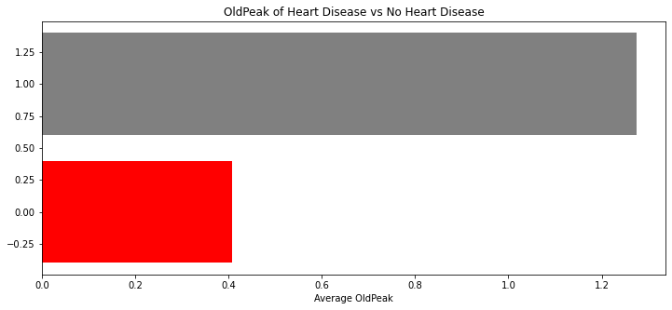
Oldpeak and Heart Disease
Notes:
While doing my analysis of the data I found that the feature with the highest correlation to Heart Disease was OldPeak. Here is a graph showing the average Oldpeak for People with heart Disease which is represented by the Gray and people without heart disease which is represented by the Red. This shows us that OldPeak is much higher for people with Heart Disease than without.

Slide 3
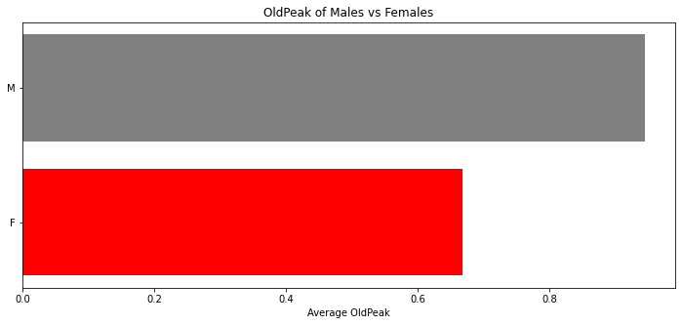
OldPeak for Men and Women
Notes:
After finding that Oldpeak had a large variance between people with and without heart disease, I then investigated the difference between the average Oldpeak of the males and females in our data set. We can see that the males have a much higher Oldpeak on average than the females. This can be useful as we already saw that high Oldpeak correlates to Heart Disease meaning that males would be more susceptible to heart disease on average than females.

Slide 4
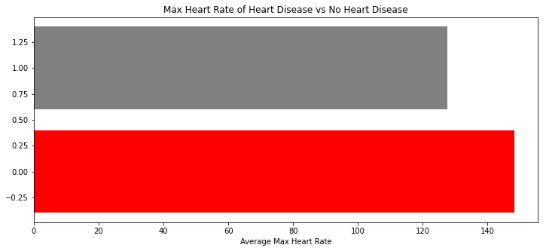
Maximum Heart Rate and Heart Disease
Notes:
I also found that Maximum Heart rate had a very high negative correlation with heart rate. This graph shows that on average people with Heart disease which is represented by the grey have a lower maximum Heart rate as the people without heart disease which are represented by the red. This can be useful when trying to detect heart disease early

Slide 5
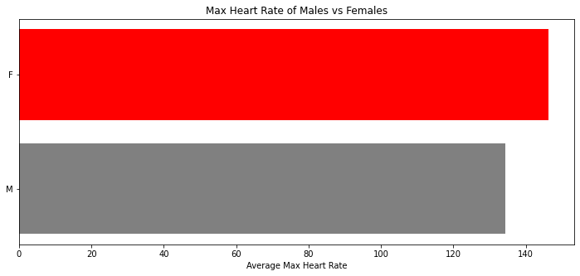
MaxHR for Men and women
Notes:
As I did with Oldpeak, I then investigated the difference between the average Maximum Heart rate of the males and females in our data set. We can see that the males have a lower Maximum heart rate on average than the females. This reinforces the possibility that males are more susceptible to heart disease as they now show having higher Old Peak and lower Maximum Heartrate

Slide 6
Model Selection
KNN vs Random Forest
KNN Train Score = 1
KNN Testing Score = .87
Random Forest Training Score = .97
Random Forest Training Score = .86
Notes:
Since my Machine learning problem was a classification problem, I chose to run a KNN classifier and a Random forest classifier. After Tuning my parameters, I found that the KNN model outperformed the Random Forest Model and was more suitable for our problem as it scored higher on both the Training and Testing data. With the higher accuracy score we will be able to reduce the amount of false positives and false negatives in our outcomes

Slide 7
Recommendations
Prescreen for high Oldpeak
Emphasize Maximum heart rate when screening
Males should go in for screening more regularly than females
Notes:
In Conclusion, to detect heart disease early, the key features that need to be taken into consideration are OldPeak, Sex, and MaxHR. We have seen that OldPeak has a positive correlation with Heart Disease as the higher the Old Peak, the higher the risk. Whereas Maximum heart rate has an equal negative correlation where the lower the max rate the higher the risk. Lastly our data showed men having higher Old peak and lower Max heart rates on average. This means that Men should get screened for heart disease on a more frequent basis.

